Slide 1
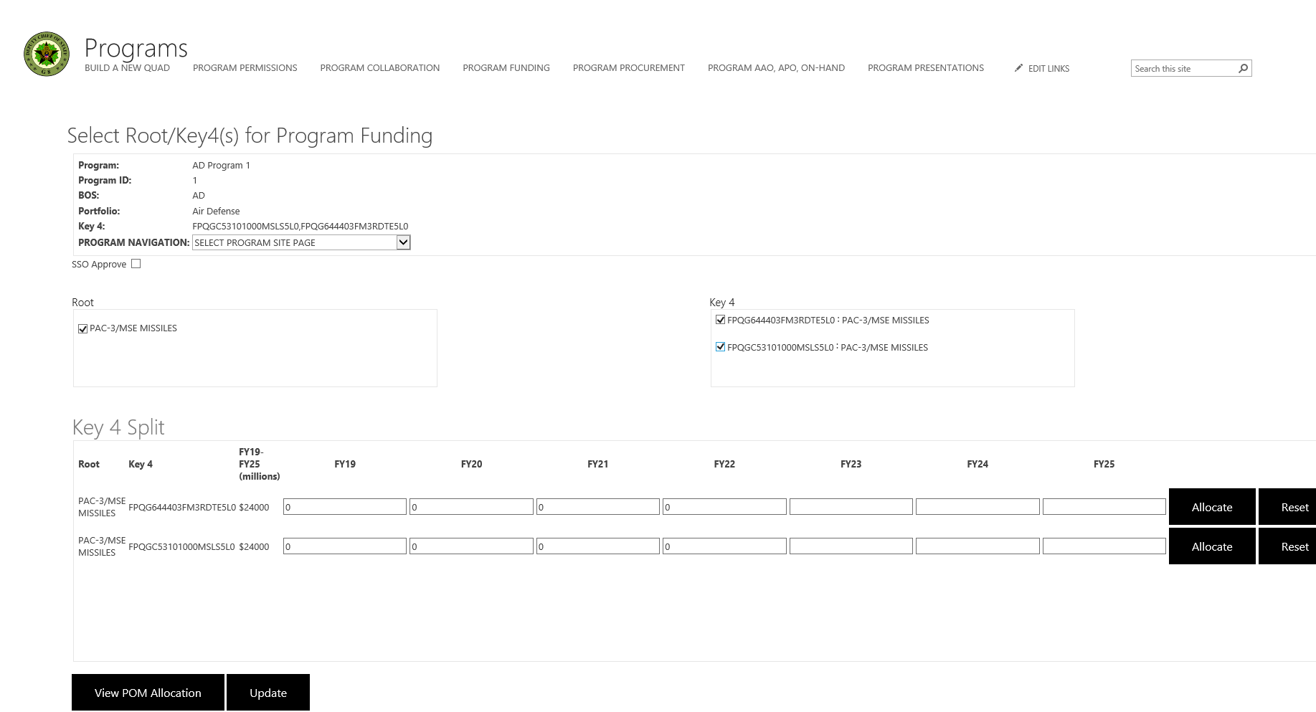
KEY 4 Calculator UI
Properties Component
App Component
SSOApprove
Component
Root Component
DeepDive Component
Key4
Component
Allocate Component
Reset Component
DeepDive
Label
Component
Key4
Component
Key4Funding Component
Root
Component
Update Component
POMModal Component

Slide 2
Key4 Calculator Component Hierarchy
App Component
Properties Component
SSO Approve Component
Root Component
Key 4 Component
DeepDive Component
DeepDive Label Component
Root Component
Key4 Component
Key4Funding Component
Allocate Component
Reset Component
POMModal Component
Update Component

Slide 3
Key4 Calculator Actions
App Component : renders 2nd level components
Properties Component: renders program properties; navigates users to different areas of
web site
SSO Approve Component: sends email to users of SSO’s approval
Root Component: renders roots
Key 4 Component: renders Key 4s
DeepDive Component : renders DeepDive,Root,Key4,Key4Funding,Allocate and Reset components
DeepDive Label Component : renders header label for deep dive allocation table
Root Component: renders roots
Key4 Component: renders key4s
Key4Funding Component: renders total dollar value for key 4 based on FYs
Allocate Component: allocates dollar value from key 4 per fy
Reset Component: resets dollar value from key 4 per fy
POMModal Component: renders POM allocation table in modal box
UpdateKey4 Component: updates program key4

Slide 4
Key4 Calculator Actions
App Component : renders 2nd level components
Properties Component: renders program properties; navigates users to different areas of
web site
SSO Approve Component: sends email to users of SSO’s approval
Root Component: renders roots
Key 4 Component: renders Key 4s
DeepDive Component : renders DeepDive,Root,Key4,Key4Funding,Allocate and Reset components
DeepDive Label Component : renders header label for deep dive allocation table
Root Component: renders roots
Key4 Component: renders key4s
Key4Funding Component: renders total dollar value for key 4 based on FYs
Allocate Component: allocates dollar value from key 4 per fy
Reset Component: resets dollar value from key 4 per fy
POMModal Component: renders POM allocation table in modal box
UpdateKey4 Component: updates program key4

Slide 5
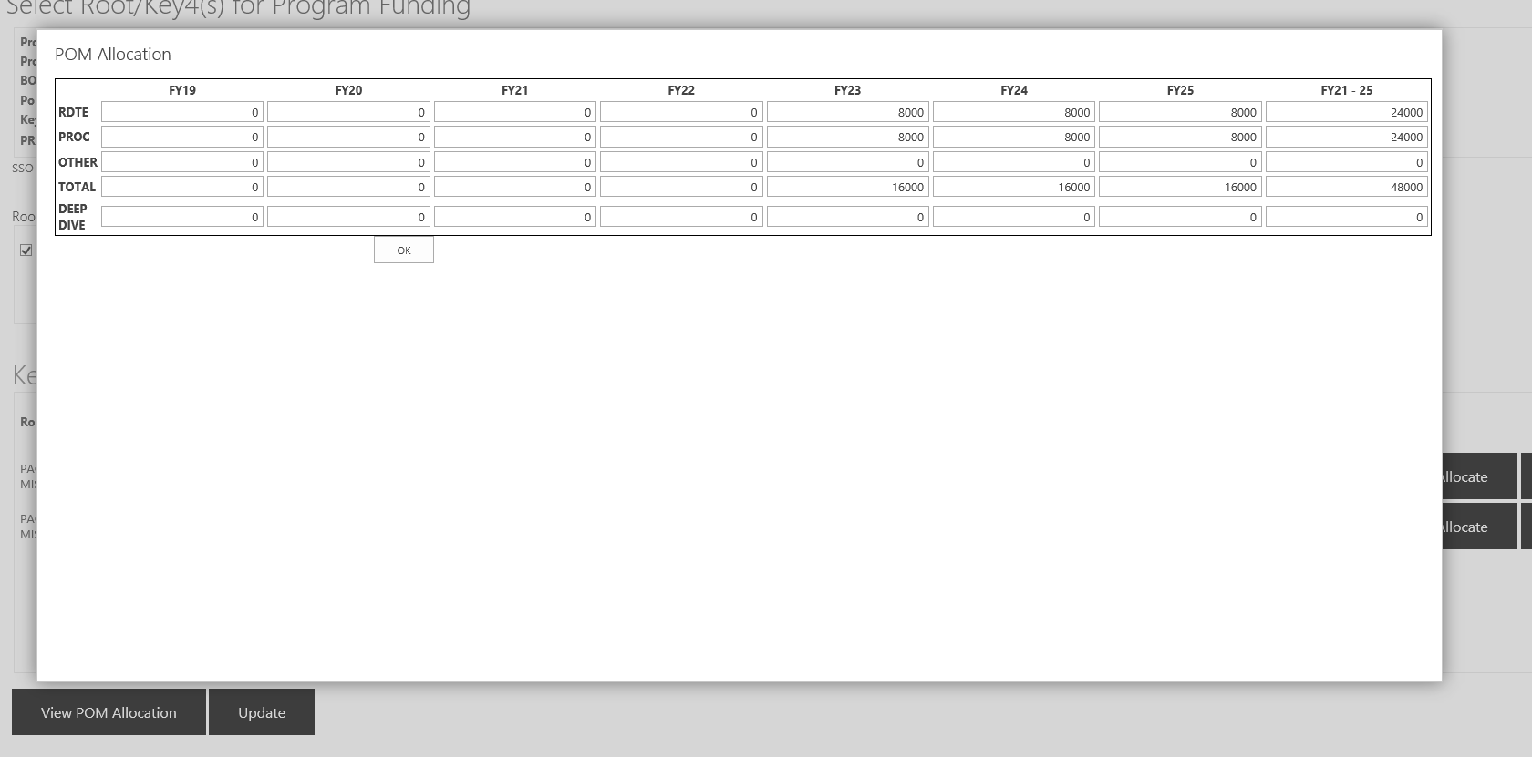
POM Modal UI
FYLabel Component
RDTE
Component
PROC
Component
OTHER
Component
TOTAL
Component
App Component
DEEPDIVE
Component
Close Component
POM Allocation Modal Appears

Slide 6
POM Modal Component Hierarchy
App Component
RDTE Component
PROC Component
OTHER Component
TOTAL Component
DEEPDIVE Component
RDTEUFR Component
PROCUFR Component
OTHERUFR Component
TOTALUFR Component
Close Component
FYLabel Component

Slide 7
POM Modal Actions
App Component: renders 2nd components
RDTE Component: renders RDTE dollar values per fy
PROC Component: renders PROC dollar values per fy
OTHER Component: renders OTHER dollar values per fy
TOTAL Component: renders TOTAL dollar values per fy
DEEPDIVE Component: renders DEEPDIVE dollar values per fy
RDTEUFR Component: renders RDTEUFR dollar values per fy
PROCUFR Component: renders PROCUFR dollar values per fy
OTHERUFR Component: renders OTHER dollar values per fy
TOTALUFR Component: renders TOTALUFR dollar values per fy
Close Component: close Modal box
FYLabel Component: renders FY labels

Slide 8
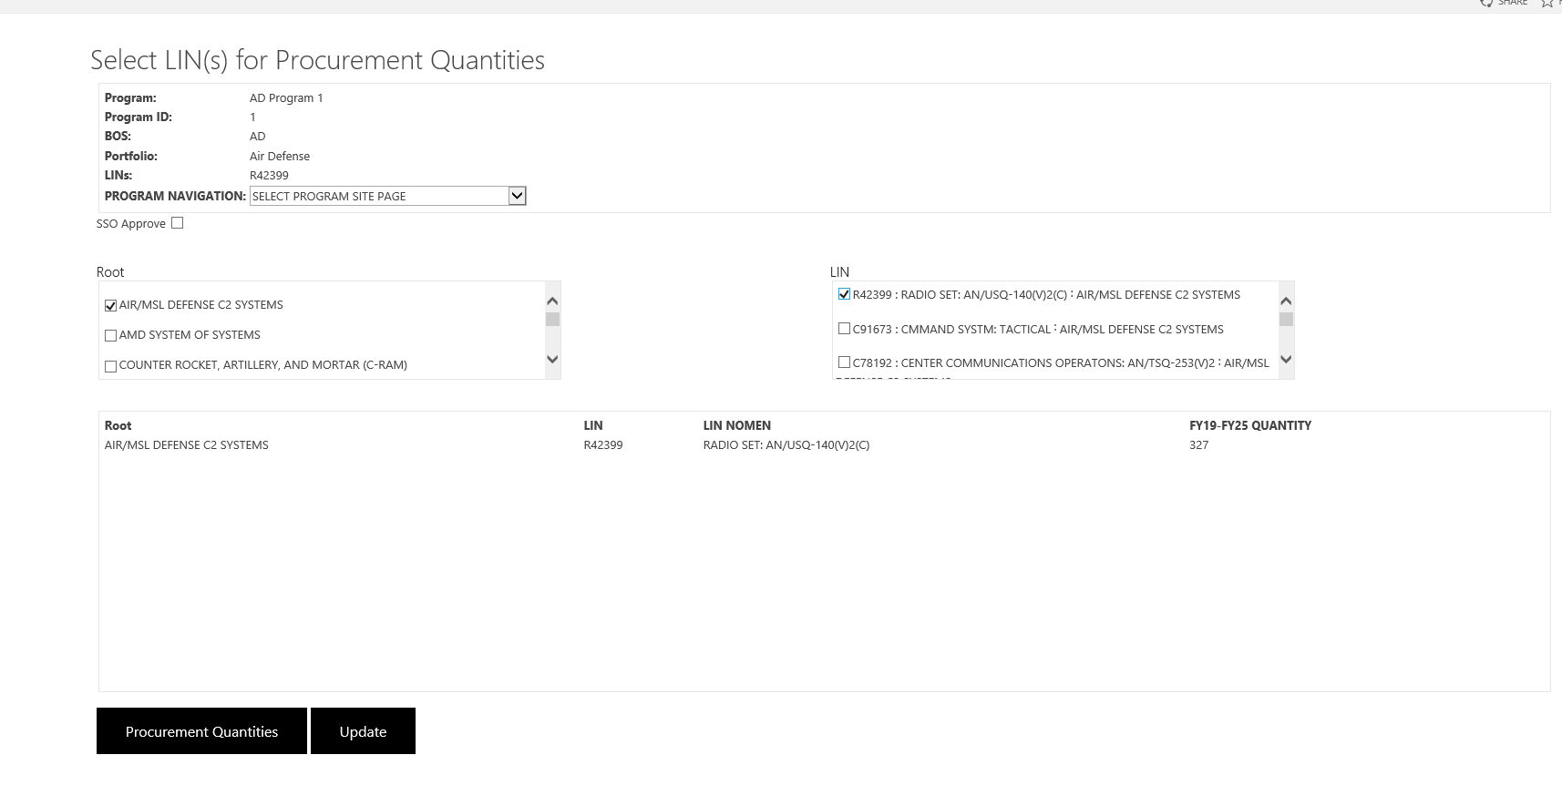
LIN Calculator UI
Properties Component
App Component
SSOApprove
Component
LIN Component
Root
Component
LINLabel
Component
Root Component
LINFunding Component
LINPanel
Component
LIN Component
LINModal Component
Update Component

Slide 9
LIN Calculator Component Hierarchy
App Component
Properties Component
SSO Approve Component
Root Component
LIN Component
LINPanel Component
Root Component
LIN Component
LIN Funding Component
LINLabel Component
LINModal Component
Update Component

Slide 10
LIN Calculator Actions
App Component : renders 2nd level components
Properties Component: renders program properties; navigates users to different areas of
web site
SSO Approve Component: sends email to users of SSO’s approval
Root Component: renders roots
LIN Component: renders LINs and LIN Nomenclatures
LINLabel Component : renders Root, LIN, and LINFunding Components
Root Component: renders roots
LIN Component: renders LINs
LINFunding Component: renders total dollar value for LIN based on FYs
LINLabel Component: renders LINPanel component header labels
LINModal Component: renders LIN table in modal box
UpdateLIN Component: updates program LIN

Slide 11
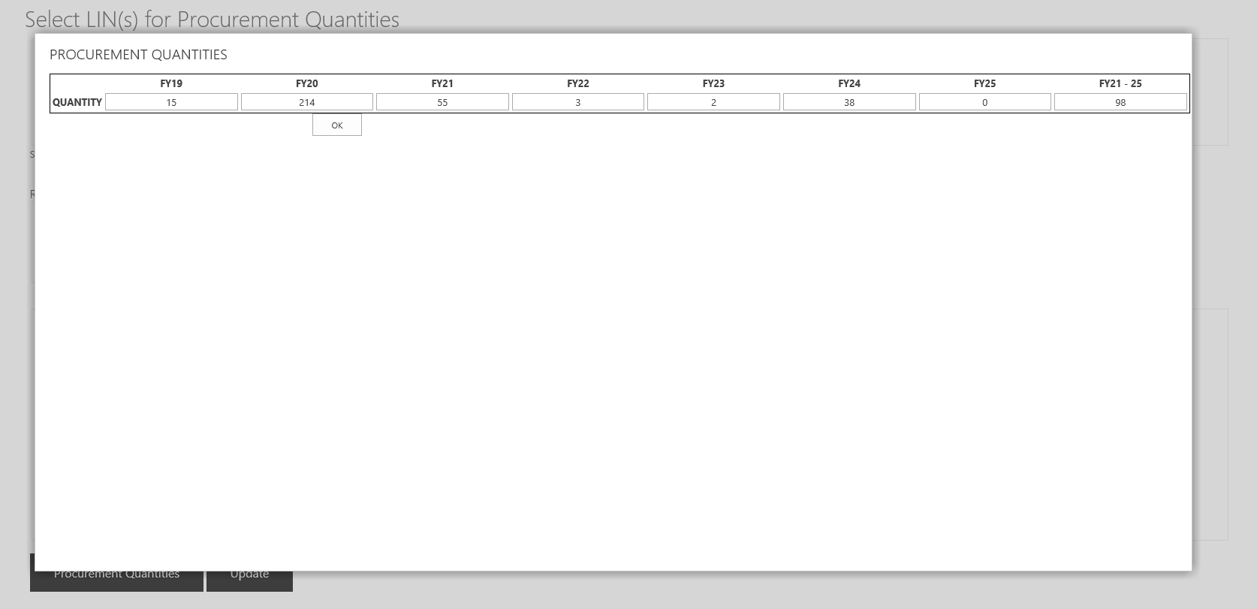
LIN Modal UI
FYLabel Component
Close Component
Quantity Component

Slide 12
LIN Modal Component Hierarchy
App Component
Quantity Component
Close Component
FYLabel Component

Slide 13
LIN Modal Actions
App Component: renders 2nd level components
Quantity Component: renders quantity dollar values per FY
Close Component: close Modal box
FYLabel Component: renders FY labels

Slide 14
Store Data
SSO Approve Component: SSO’s Approval Email
Root Component: roots
Key 4 Component: Key 4s
Key4Funding Component: total dollar value for key 4 based on FYs
Allocate Component: total dollar value for key 4 based on FYs
Reset Component: total dollar value for key 4 based on FYs
POMModal Component: POM allocation table in modal box
UpdateKey4 Component: program key4
RDTE Component: renders RDTE dollar values per fy
PROC Component: renders PROC dollar values per fy
OTHER Component: renders OTHER dollar values per fy
TOTAL Component: renders TOTAL dollar values per fy
DEEPDIVE Component: renders DEEPDIVE dollar values per fy
RDTEUFR Component: renders RDTEUFR dollar values per fy
PROCUFR Component: renders PROCUFR dollar values per fy
OTHERUFR Component: renders OTHER dollar values per fy
TOTALUFR Component: renders TOTALUFR dollar values per fy
LIN Component: renders LINs and LIN Nomenclatures
LINFunding Component: total dollar value for LIN based on FYs
LINModal Component: FY LIN dollar values
UpdateLIN Component: program LINs

Slide 15
Component Data
App Component : 2nd level components
Properties Component: program properties labels; navigates users to different areas of
web site
DeepDive Component : DeepDive,Root,Key4,Key4Funding,Allocate and Reset components
POMModal Component: POM allocation table in modal box
UpdateKey4 Component: program key4
Close Component: Modal box
FYLabel Component: FY labels

Slide 16
Action Constants
SSO Approve Component: GET_SSO_APPROVAL
Root Component: GET_ROOTS
Key 4 Component: GET_KEY4s, GET_APPROPRIATION
Key4Funding Component: total dollar value for key 4 based on Fys : GET_KEY4_APPROPRIATION_FY_DOLLARS
Allocate Component: total dollar value for key 4 based on FYs : GET_KEY4_TOTAL_DOLLARS, GET_ALLOCATED_KEY4_TOTAL_DOLLARS
Reset Component: total dollar value for key 4 based on FYs: GET_KEY4_TOTAL_DOLLARS
POMModal Component: POM allocation table in modal box: GET_POM_MODAL
UpdateKey4 Component: program key4: GET_PROGRAM_KEY4
RDTE Component: renders RDTE dollar values per fy: GET_RDTE_DOLLARS
PROC Component: renders PROC dollar values per fy: GET_PROC_DOLLARS
OTHER Component: renders OTHER dollar values per fy: GET_OTHER_DOLLARS
TOTAL Component: renders TOTAL dollar values per fy: GET_TOTAL_DOLLARS
DEEPDIVE Component: renders DEEPDIVE dollar values per fy: GET_DEEP_DIVE_DOLLARS
RDTEUFR Component: renders RDTEUFR dollar values per fy: GET_RDTEUFR_DOLLARS
PROCUFR Component: renders PROCUFR dollar values per fy: GET_PROCUFR_DOLLARS
OTHERUFR Component: renders OTHERUFR dollar values per fy: GET_OTHERUFR_DOLLARS
TOTALUFR Component: renders TOTALUFR dollar values per fy: GET_TOTALUFR_DOLLARS
LIN Component: renders LINs and LIN Nomenclatures: GET_LIN
LINFunding Component: total dollar value for LIN based on Fys: GET_LIN_DOLLARS
LINModal Component: FY LIN dollar values: GET_LIN_DOLLARS
UpdateLIN Component: program LINs:GET_PROGRAM_LINS

